Slide 1
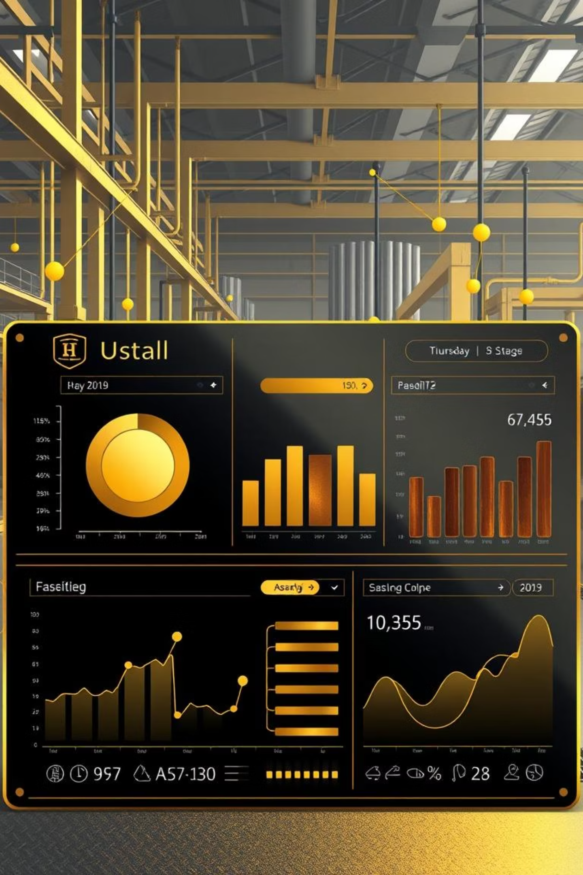
Manufacturing Performance Dashboard
Presented by:
Rohitgouda.

Slide 2
The Challenge: Lack of Production Visibility
Our client faced significant hurdles in understanding their manufacturing efficiency and quality. Critical gaps in data hindered their ability to make informed decisions:
Inconsistent tracking of production versus rejection rates across different stages.
Absence of detailed insights into rejections attributed to specific employees, machines, or departments.
Ineffective tracking and quantification of material wastage.
Limited understanding of long-term production trends and their impact on overall output.
Without these crucial insights, bottlenecks remained hidden, efficiencies were elusive, and the true cost of production flaws went unaddressed.

Slide 3



Our Solution: A Data-Driven Approach
1. Data Collection
We initiated by gathering raw manufacturing data, specifically CSV files containing critical information on production runs, employee performance, machine output, and departmental contributions.
2. Data Cleaning & Integration
The collected data was imported into a MySQL database. Our team meticulously cleaned the data, correcting inconsistencies in dates, handling blank entries, and rectifying negative wastage values to ensure data integrity.
3. KPI Design
Working closely with the client, we defined a comprehensive set of Key Performance Indicators (KPIs) essential for monitoring manufacturing health:
Production Volume
Processed Units
Rejected Units
Wastage Percentage
Rejection rates segmented by Employee, Machine, and Department
Production and Rejection Trends over time
4. SQL Analysis
Advanced SQL queries were employed to aggregate and group the data. We transformed raw numbers into meaningful percentages, thousands, and millions, while carefully removing any noisy or irrelevant rows to distill actionable information.
5. Actionable Insights
Through rigorous analysis, we successfully exposed critical rejection hotspots, accurately tracked evolving production trends, and quantified the financial impact of wastage, providing the client with unprecedented operational clarity.

Slide 4
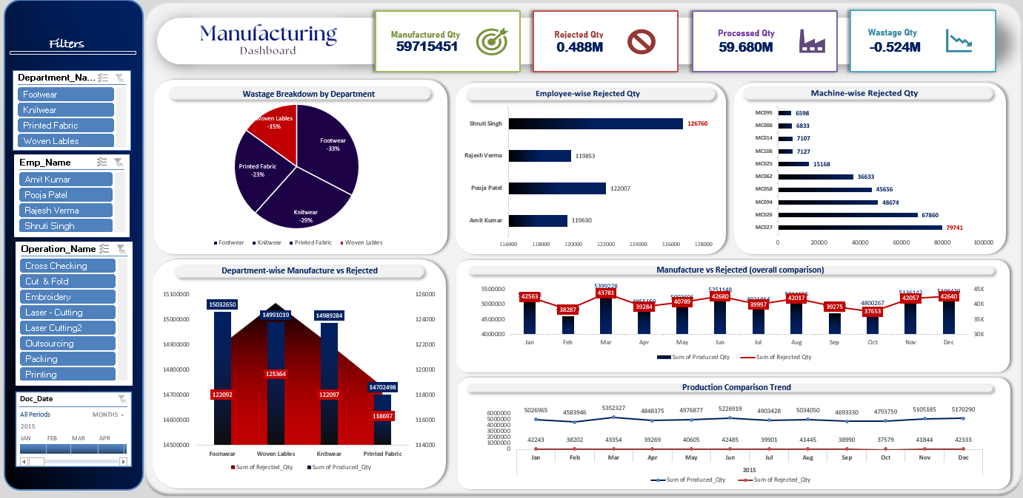
EXCEL DASHBOARD

Slide 5
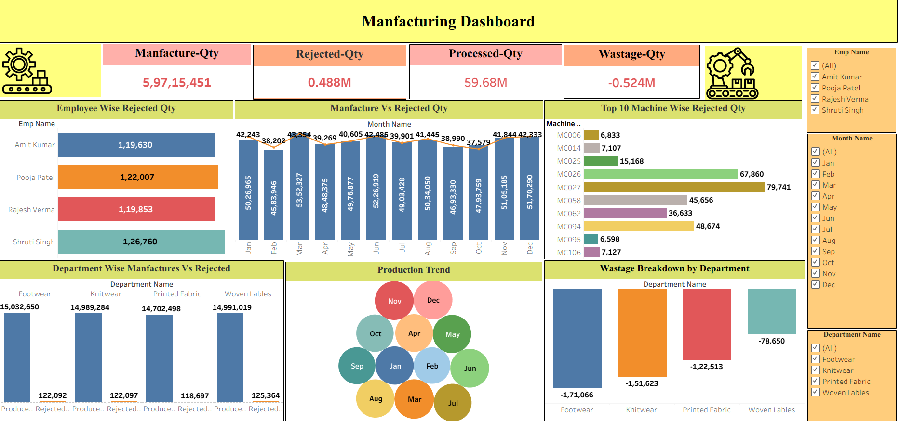
TABLEAU DASHBOARD

Slide 6
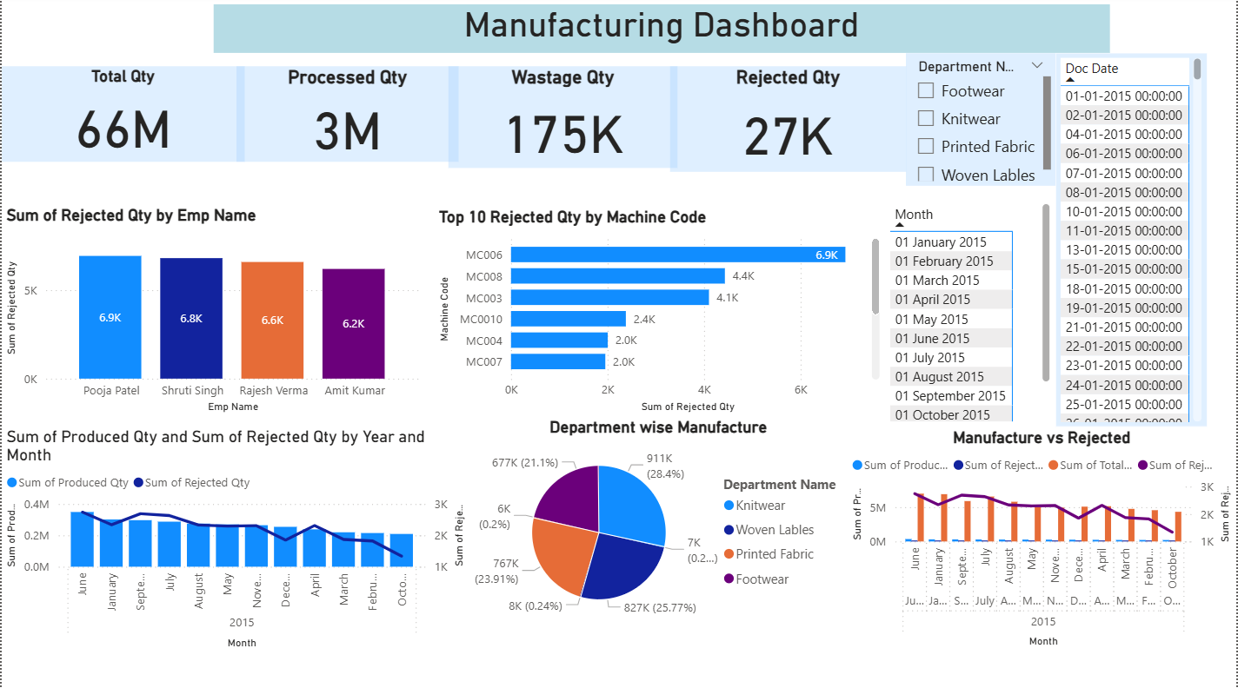
POWER BI DASHBOARD

Slide 7
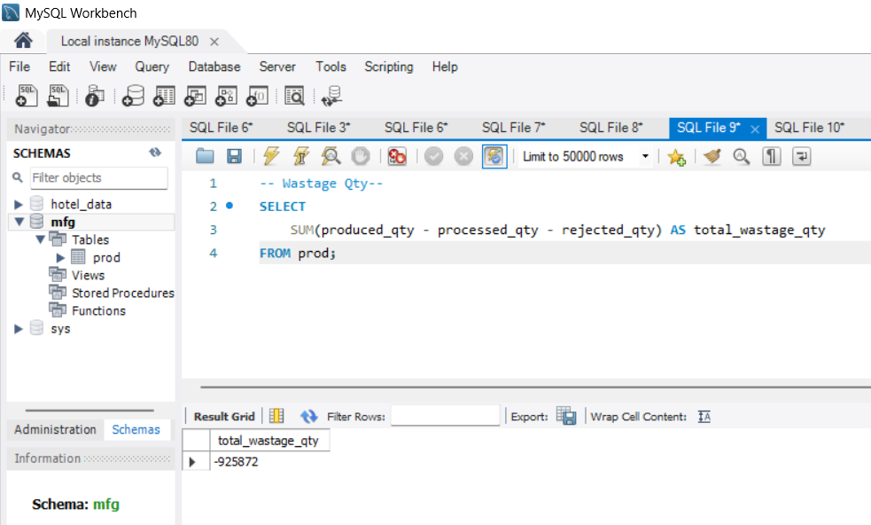
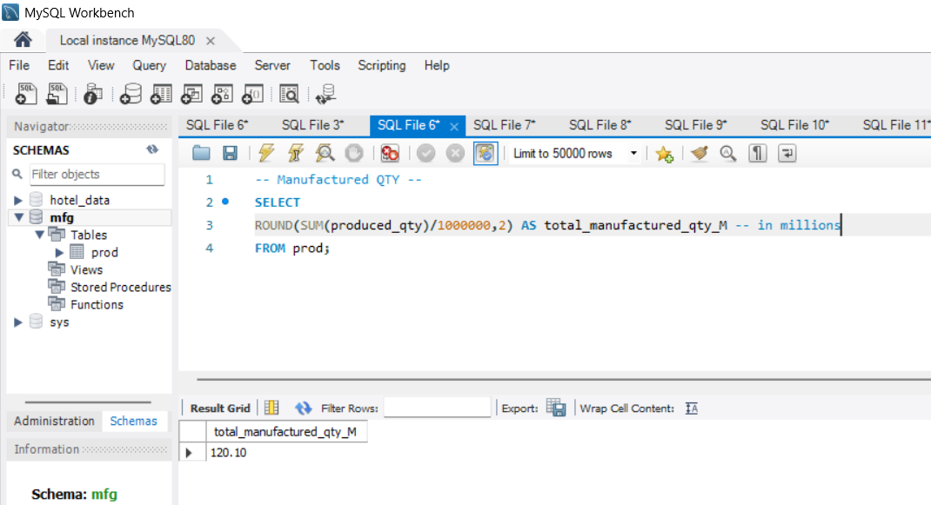
SQL OUTPUT SNAPSHOTS

Slide 8
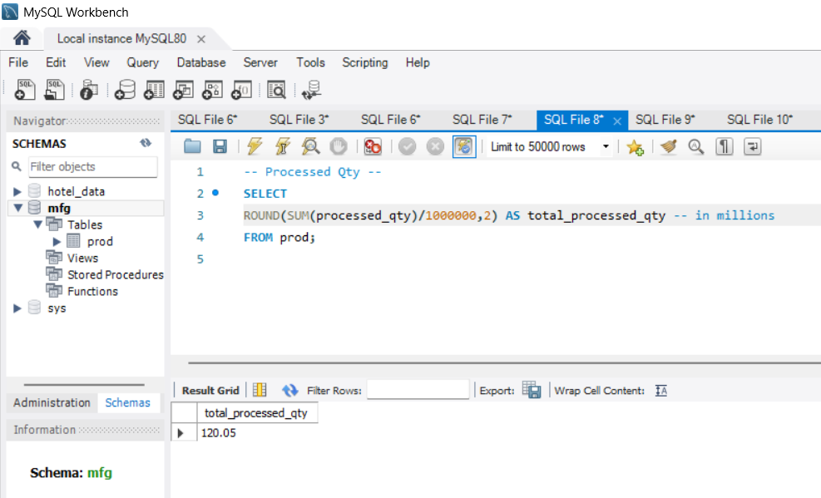
SQL OUTPUT SNAPSHOTS

Slide 9
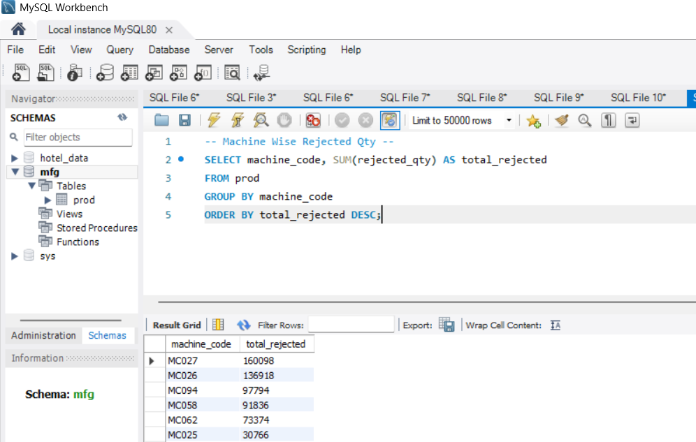
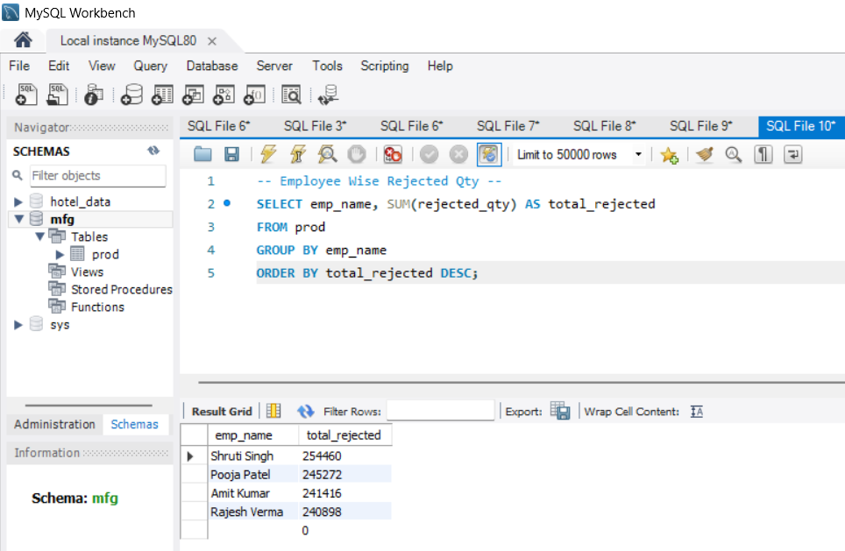
SQL OUTPUT SNAPSHOTS

Slide 10
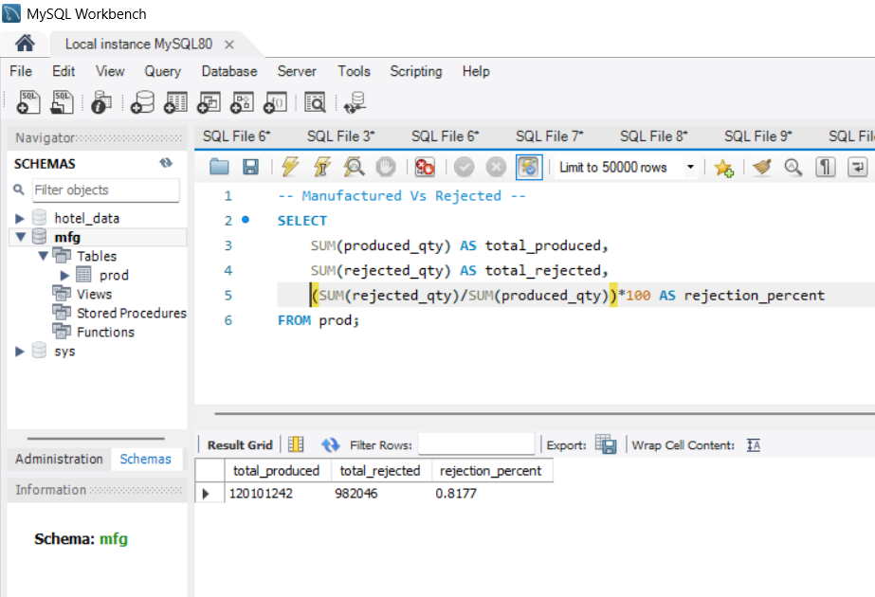
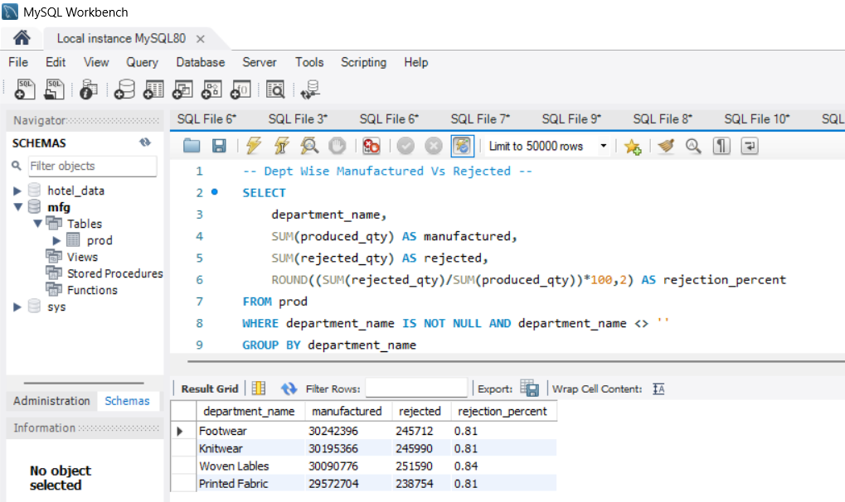
SQL OUTPUT SNAPSHOTS

Slide 11
Strategic Recommendations for Improvement
Based on the dashboard's insights, we recommend the following strategic actions to optimize manufacturing performance:
🎯 Focus Training
⚙ Maintenance First
🏭 Departmental Accountability
Identify and target employees with consistently higher rejection percentages for specialized training programs. This direct intervention will enhance skill sets and reduce errors at the source.
Prioritize maintenance for underperforming machines indicated by high rejection rates. Proactive servicing will minimize breakdowns and ensure consistent quality output.
Foster a culture of accountability by regularly comparing rejection percentages across departments. This encourages best practices and healthy competition to improve quality.
📈 Forecast & Align
♻ Cut the Waste
Utilize production trend data to accurately forecast future demands and align resource planning around anticipated production peaks, optimizing efficiency and preventing bottlenecks.
Implement process optimization initiatives specifically targeting areas identified with high material loss. Reducing waste directly impacts profitability and sustainability.

Slide 12



Key Metrics for Sustained Success
To ensure ongoing optimization, focus on these critical metrics:
95%
10%
98%
Overall Equipment Effectiveness (OEE)
Scrap Rate Reduction
First-Pass Yield
Targeting a significant decrease in material waste through continuous process improvement.
Maximizing the percentage of products that meet specifications on the first production run.
A critical measure reflecting availability, performance, and quality of production assets.

Slide 13
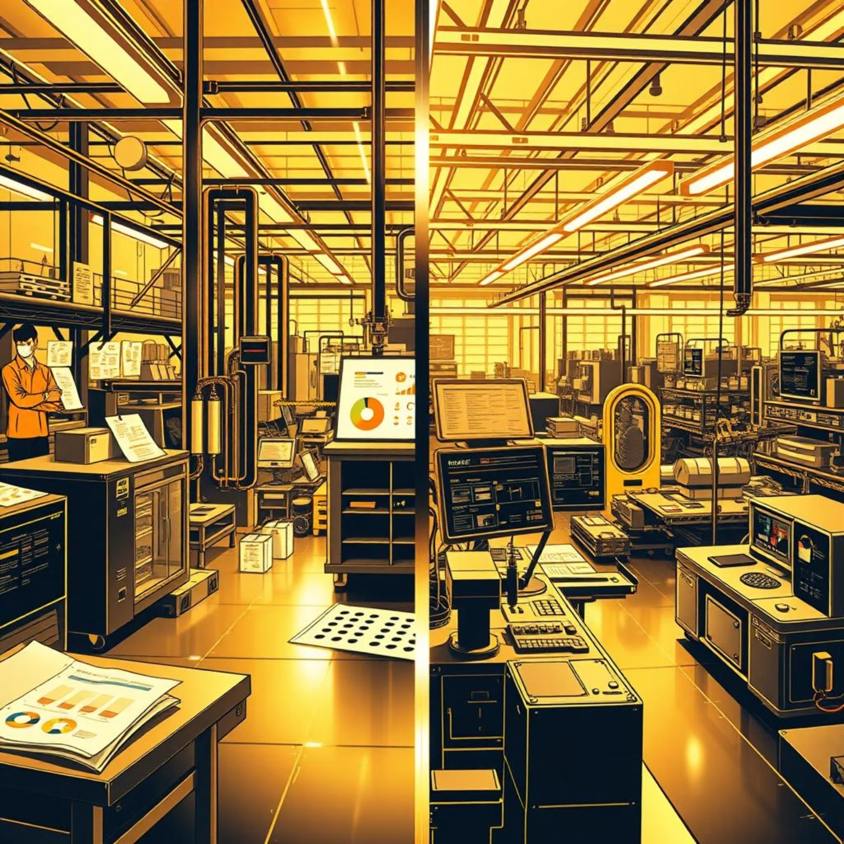
Conclusion: Empowering Data-Driven Manufacturing
Our manufacturing performance dashboard has provided the client with unprecedented clarity into their operational health, efficiency, and quality.
Real-time visibility means immediate identification of issues.
Comprehensive KPIs offer a holistic view of the production line.
This solution enables truly data-driven decisions that can significantly reduce wastage, improve product quality, and optimize overall manufacturing performance. With continuous tracking and strategic interventions, rejection percentages can be consistently lowered, leading to enhanced profitability and a stronger competitive edge.

